Slide 1
It’s Your Time!
Engage ... Participate

Slide 2
“Why do people get involved?”
Notes:
Have the participants think about this question while watching the following two videos

Slide 3
https://www.youtube.com/watch?v=s7L1jFog8zE

Slide 4
https://www.youtube.com/watch?v=rq3QXIVR0bs

Slide 5
“Why do people get involved?”
Notes:
They are passionate about issues that aren’t being addressed, and they want to make a change in their community.

Slide 6
Get Involved: 5 steps d 1: Who Are You? 2: What Do You Stand For? 3: Making It Real 4: It’s Your Time! 5: Teens Who’ve Done It
1
2
3
4
5

Slide 7
Who Are You?
What social groups make you, you?

Slide 9
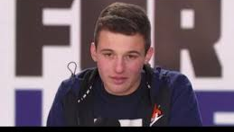
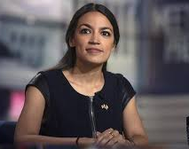
What communities are they speaking to and representing?
Cameron Kasky
Alexandria Ocasio-Cortez

Slide 10
Activity 1: What communities are you a part of?
Use three of the stickies provided, and write on each one of the communities you are involved in.
Place them on the board on the wall in the correct section on the matrix (social groups, geographic location, online/social media, or personal relations).

Slide 11
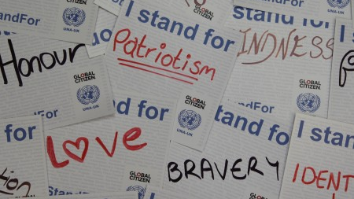
Groups gather around a set of values
What are yours?

Slide 12
What Do You Stand For?
What are your values, and how do you convert them to action?

Slide 13
From Global Youth Village, http://www.globalyouthvillage.org/
https://www.youtube.com/watch?v=fPdNbCtb16g

Slide 14
Activity 2: What are your values?
Take the list of values in your handout and circle 5-10 of them.

Slide 15
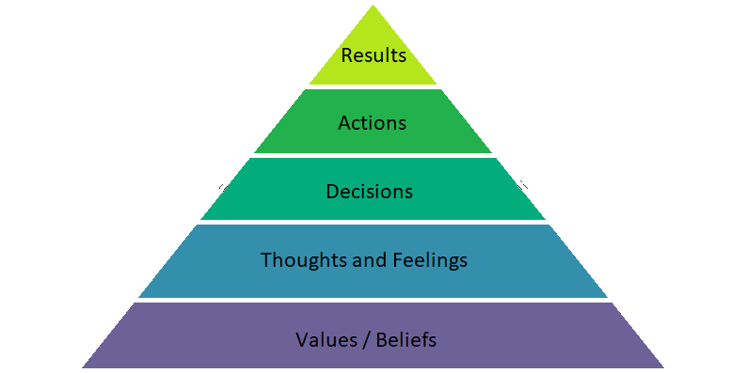
How to convert values to actions and results? 1 Use the diagram to help you answer

Slide 16
Your values, thoughts, and feelings will help you get involved.

Slide 17
Making It Real
What upsets you in your community?

Slide 18
What’s a Healthy Community?
Basic Needs
Community Attitudes
Community Values

Slide 19
A Healthy Community
Connection
Belonging
Lack of Prejudice
Inclusiveness
Security
Community Spirit
Basic Needs
Community Values
Respect
Trust
Honesty
Openness
Dependability
Acceptance
Sufficient Resources
Safety
Health
Organization
Cleanliness
Employment Opportunities
Community Attitudes

Slide 20
What makes communities healthy?
Choose one community you are involved in. Write down:
3 things that makes it healthy?
3 things that need to be improved?

Slide 21
Finding Your Issues
What in your community:
Ticks you off?
Are you dissatisfied with?
Could be improved?
Is missing?

Slide 22
Activity 3: Finding Your Issues
Pick three things that upset you about your community or could be improved. Write them down and share one with the group.

Slide 23
It’s Your Time!
What helps and what gets in the way of getting involved

Slide 24
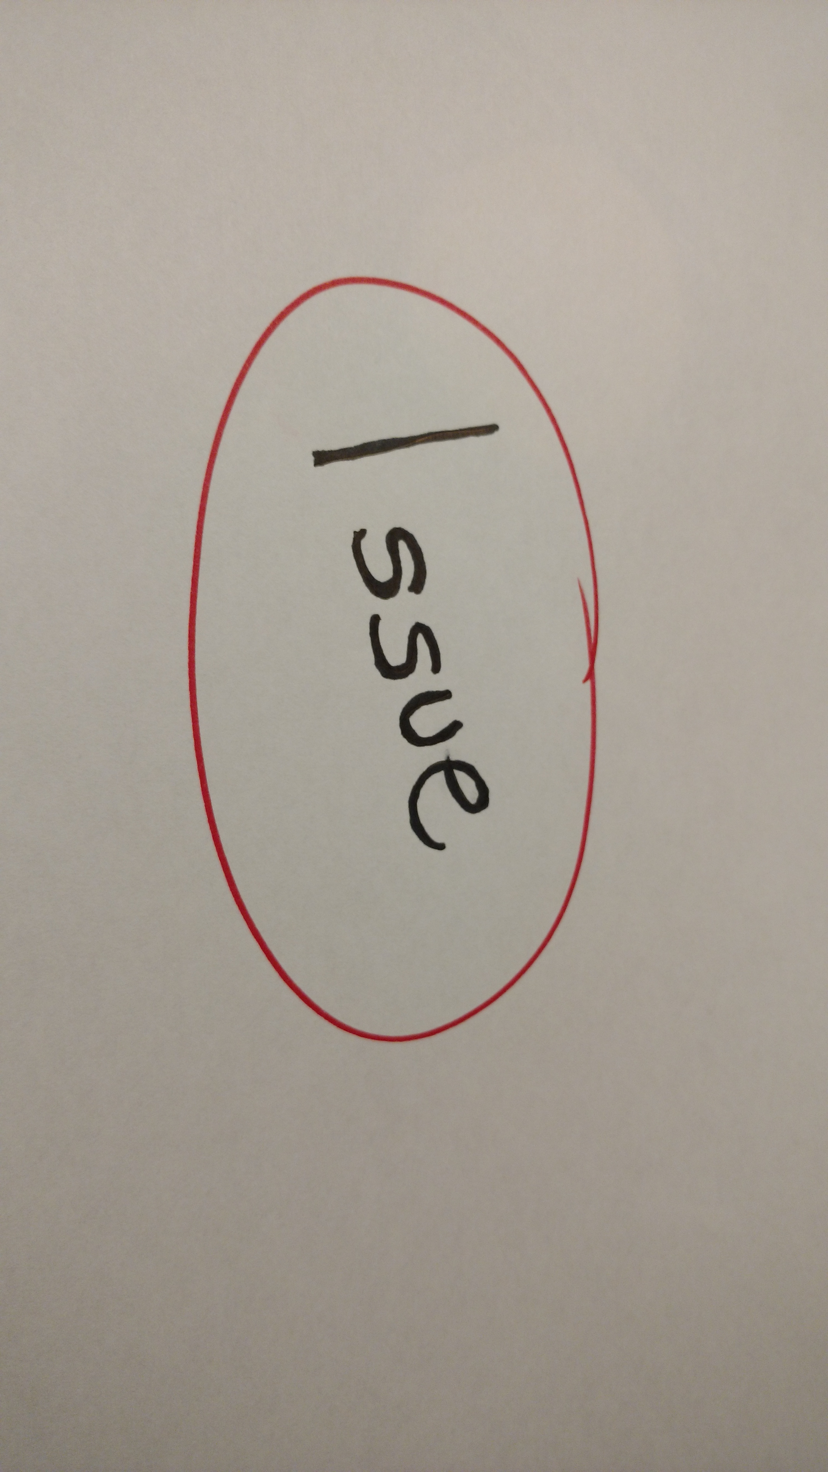
Picking an Issue
Pick one issue from your list from Activity 3 about what upsets you or could be improved and circle it.
This is the issue you will be focusing on later.

Slide 25
Three Ways to Get Involved
1. Personal Action
2.work with existing organization
3. share the story, spread the word

Slide 26
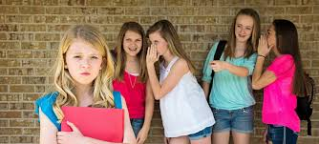
Example 1: Bullying
Three ways to get involved:
PERSONAL ACTION: educate yourself about what bullying is, and how to prevent it. Make an effort to stop bullying people, and support people who are bullied by others
WORK WITH ORGANIZATION: talk with teachers and administrators in your school about being on a school safety committee or speaking to the student body about bullying
SPREAD THE WORD: make posters to put up around your school spreading awareness about bullying and how to prevent it

Slide 27
Activity 4: Get Involved With Your Issue
Use your own issue, and come up with 3 ways you can get involved: a personal action, work with an existing organization, and spreading the word.
After you have these 3, discuss your ideas with your partner(s) and give each other suggestions.
Notes:
Work with Sam

Slide 28
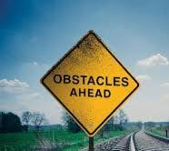
Will you really do something when you get home??
There are many things that can prevent you from getting involved.

Slide 29
It can be scary to put yourself out there
By getting involved in your community, you could be putting yourself into a spotlight, an uncomfortable conversation, or a dangerous situation. However, it is worth it!
Notes:
quotes

Slide 30
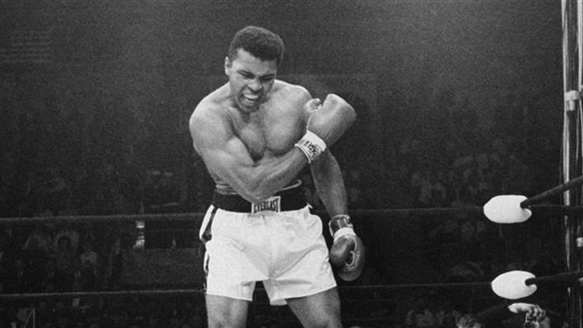
“He who is not courageous enough to take risks will accomplish nothing in life” –
Muhammad Ali, boxer

Slide 31
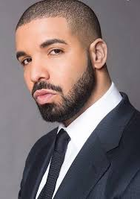
“When you look ahead and darkness is all you see, faith and determination will pull you through,” – Drake, rapper

Slide 32
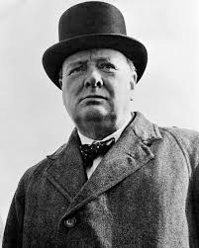
“Success is not final, failure is not fatal: it is the courage to continue that counts,”– Winston Churchill, Prime Minister of England during World War II

Slide 33
Activity 5: Finding the Time
You must evaluate your priorities to make time to get involved.
In your handbooks, fill out Activity 5 table.

Slide 34
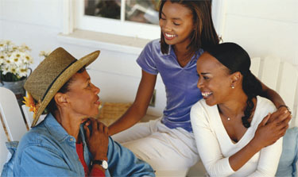
Getting help
Impact Center as a resource
List of organizations
Search to find organizations in your area
Support of parents/ guardians/ other mentors

Slide 35
Teens Who’ve Done It
Teens who have made a difference, on a large and small scale

Slide 36
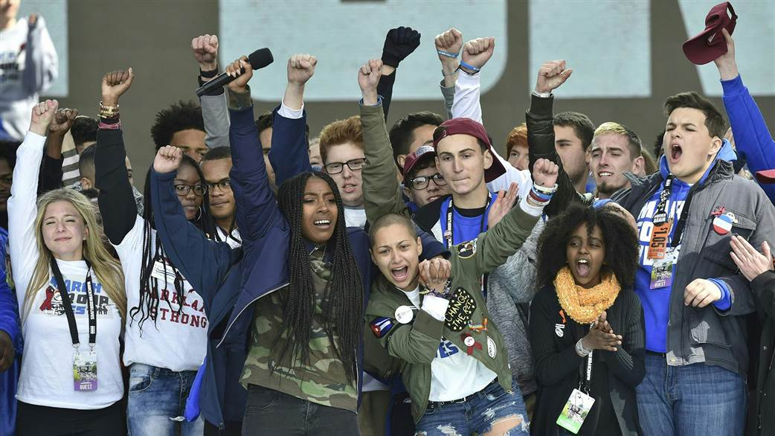
#NeverAgain

Slide 37
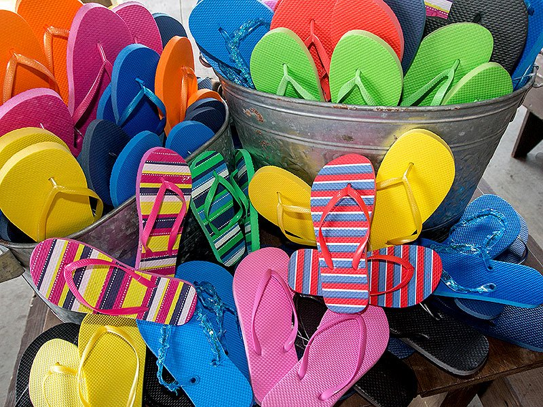
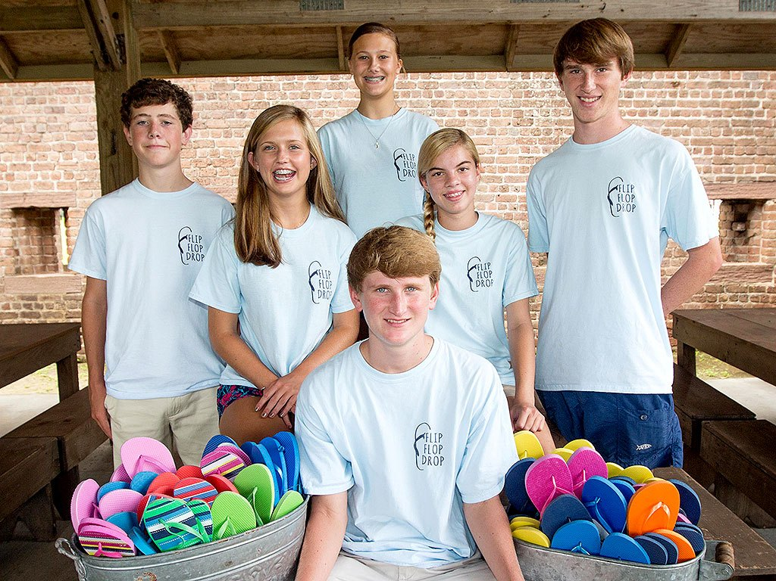
Daniel Mahoney and the Flip Flop Drop
Daniel Mahoney and his five friends helped the Inner City Night Shelter (ICNS), a homeless housing facility in Savannah, Georgia, by raising money to buy 3,200 pairs of flip flops to give to homeless people in need of shower shoes for the dirty showers.
They raised awareness about their cause in the local news, and then did fundraising around their community.
https://people.com/human-interest/heroes-among-us-georgia-teens-help-homeless/

Slide 38
https://www.youtube.com/watch?v=ctP9I-lT6kc

Slide 39
Activity 6: Community Needs Survey
Perform this survey in your community to learn about more issues affecting community members.
Send an email to the Impact Center telling them about your experiences, and you will be sent a certificate for the training.

Slide 40
Takeaways What part of the training sticks with you?

Slide 41
Created for Impact Center d Diyaa Kaufman, Girl Scout Gold Award August 2018 ©DiyaaKaufman2018
Special Thanks to:
Shanti Thompson
Ira Kaufman
Molly Deegan
Legacy International
Sam Rasoul

Slide 42
Quick Survey
A few questions to help us improve the training

Slide 43
What did you like best about the training?

Slide 44
What did you like least about the training?

Slide 45
When were you most bored? Why?

Slide 46
What was the best activity? The worst activity?

Slide 47
Was the training too long? Too short?

Slide 48
Do you think you can use the information you learned to get involved? If so, what will you do?

